Slide 1
Aadhaar Address Update
Securely update your aadhaar address

Slide 2
Table of Contents
01
03
02
04
Problem vs Solution
Tech Stack
Security Considerations
Our Product

Slide 3
Problem and Solution
Aadhaar address update needs a straight-forward solution. Our app introduces a novel way for home-to-home operators to update address without introducing any privacy concerns

Slide 4
Our Product
We introduce an app that uses the VID API of Aadhaar to generate a temporary key to uniquely identify the resident without exposing the aadhaar number to the operator.
We use OCR to extract text from the supporting document from which the operator can remove the redundant text and OCR errors, if any.
The resident can then approve the changes and the aadhaar address is updated.

Slide 5
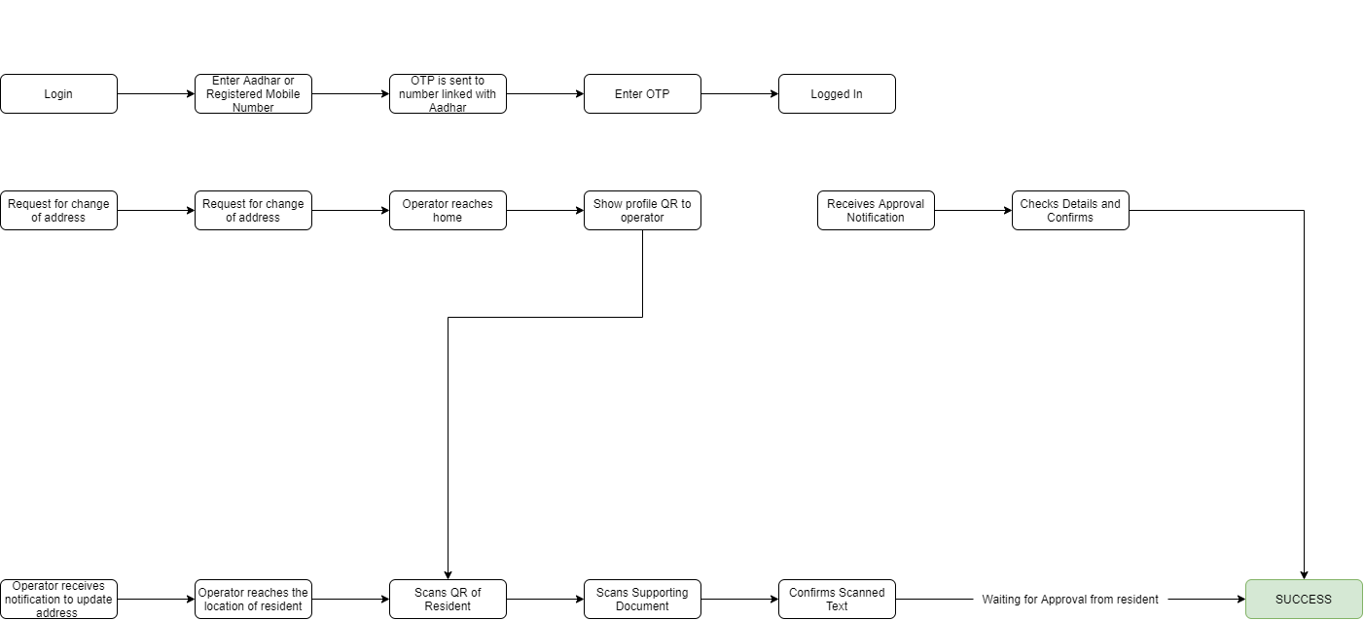
Application Flow

Slide 6
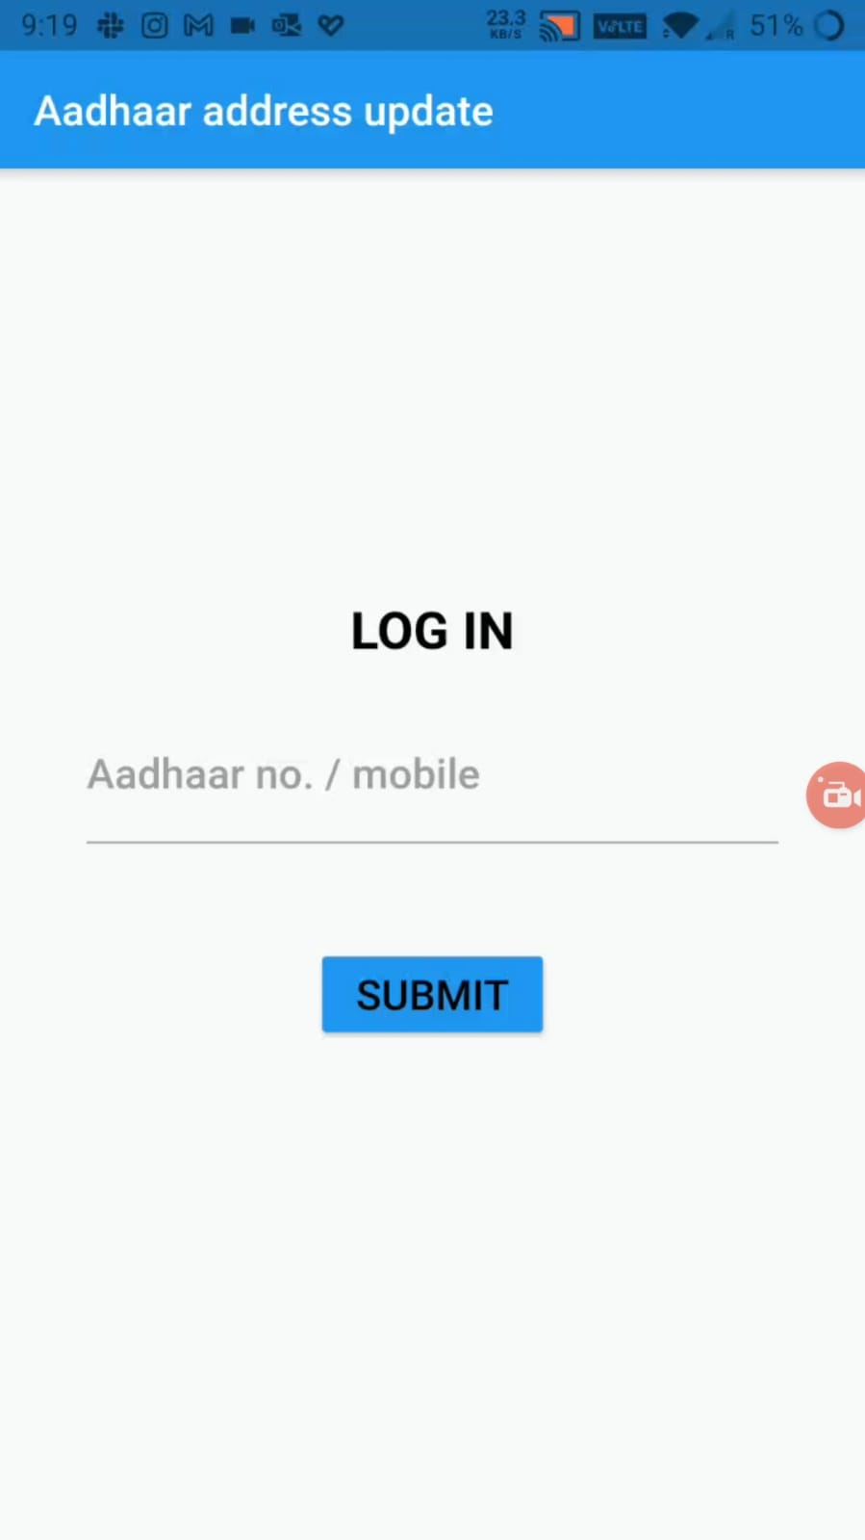
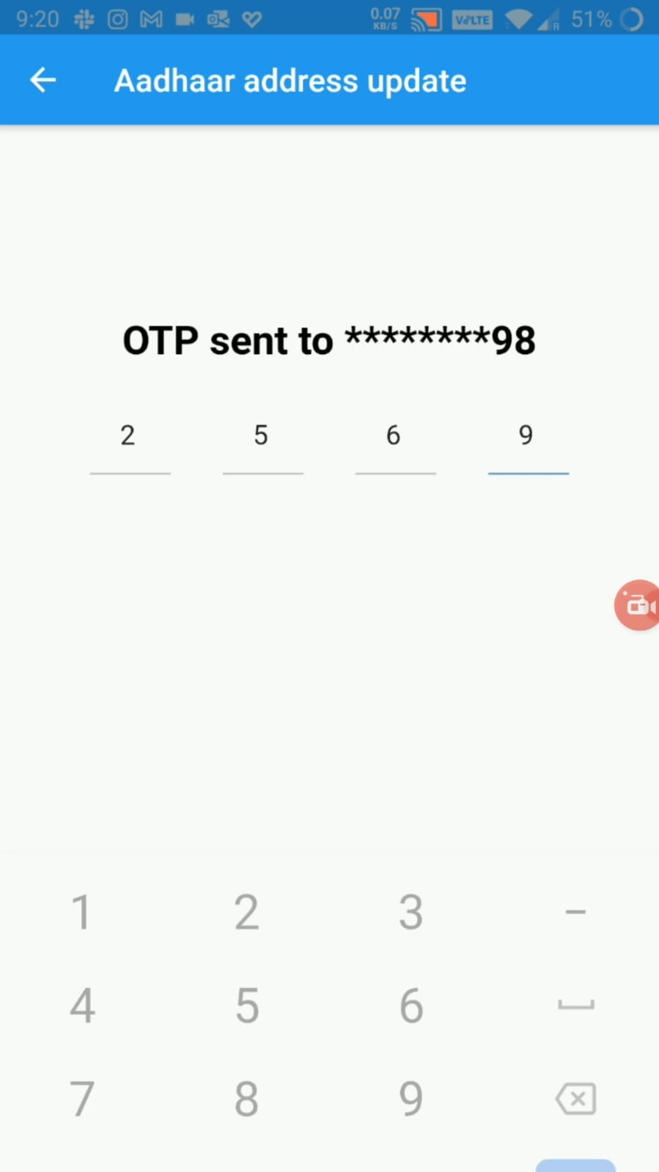
Operator Side Screens

Slide 7
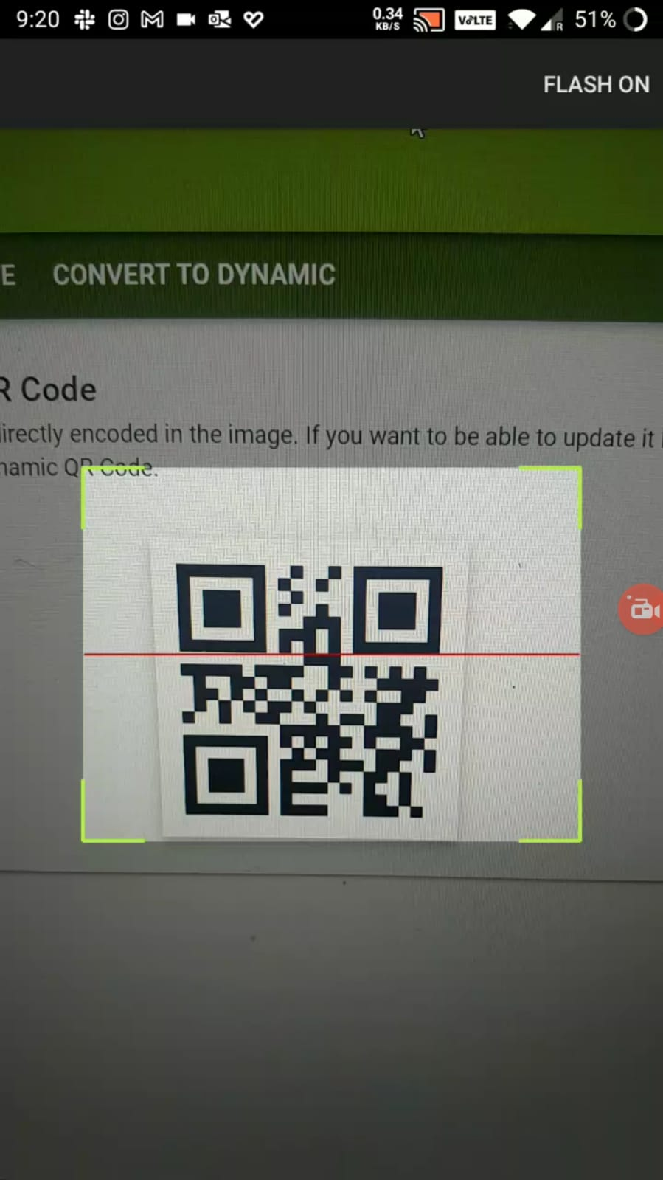
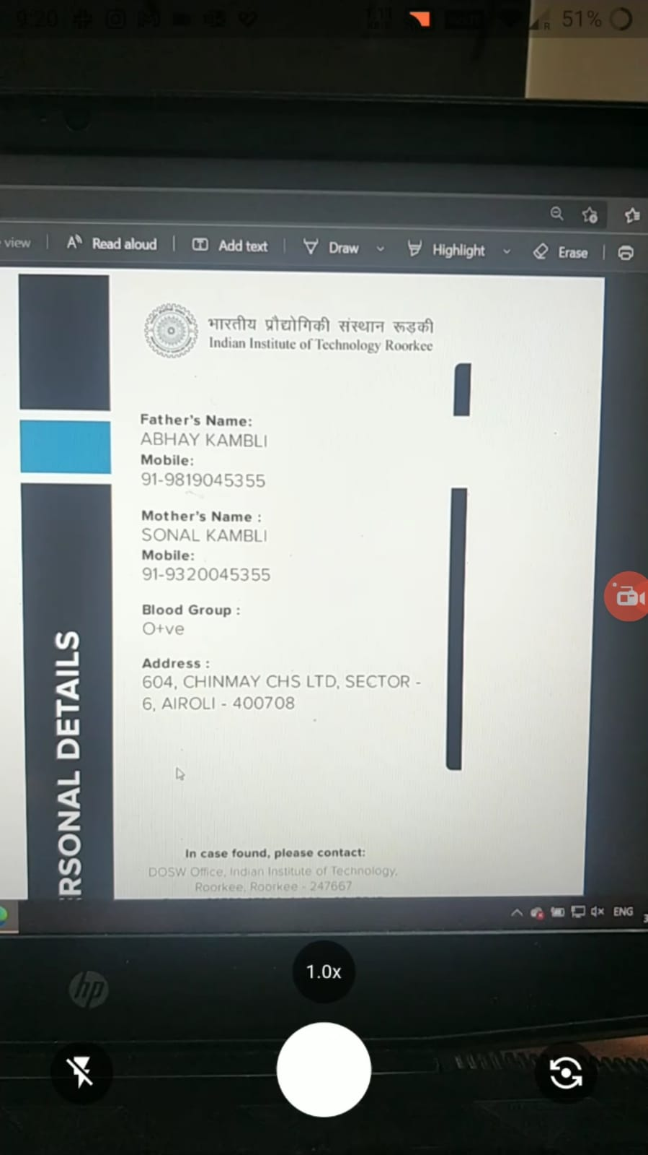
Operator Side Screens

Slide 8
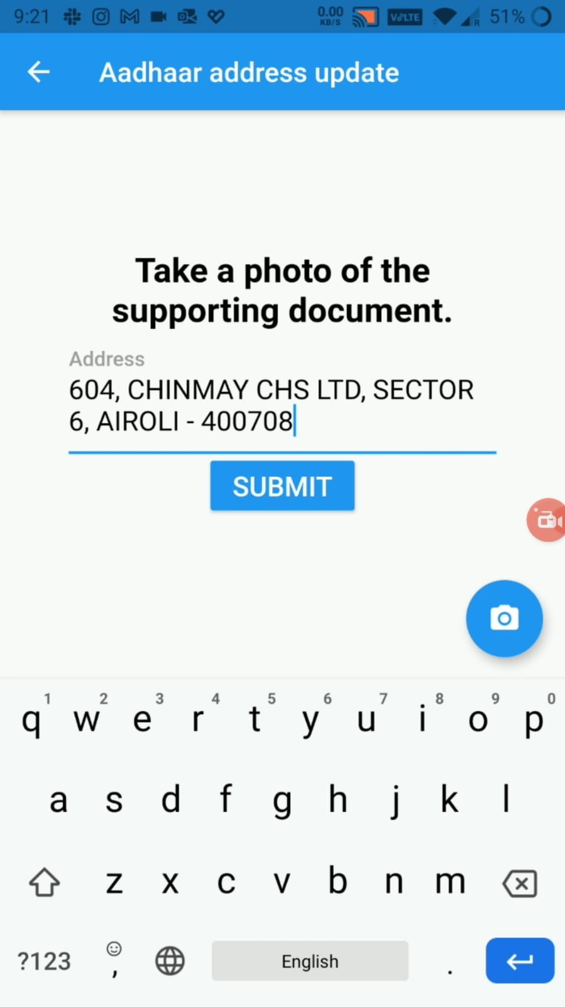
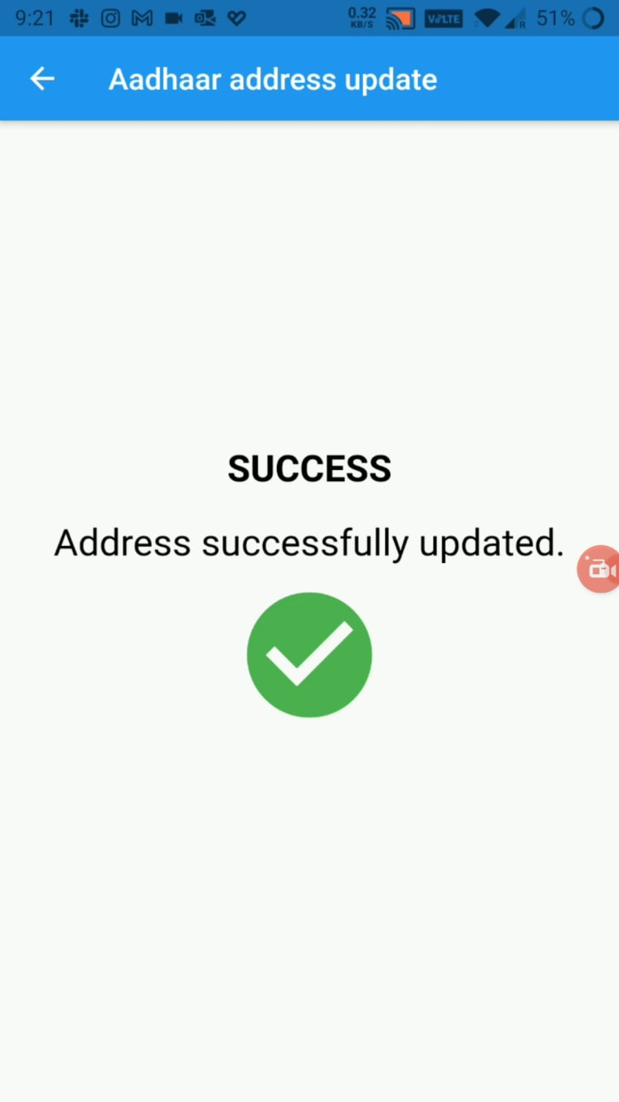
Operator Side Screens

Slide 9


Tech Stack
Flutter
nodeJS
The frontend mobile app is made in Flutter which allows us to make performant apps that compile to both Android and iOS
The backend is made in nodeJS. We have made a scalable and highly secure REST API to serve the requests.

Slide 10
Security Considerations
The whole app is built keeping in mind the principle of least privilege.
We use VID generator API so that the resident doesn’t have to disclose aadhar number to the operator.
Use of encrypted network protocols throughout the app.
All user data is encrypted in both while storage and transfer.

Slide 11





Team TouchMeNorth
Stuti Lilani
Meet Shah
Aditya Bisht
Angad Kambli
Priyansh Rathi

